Slide 1

AWS Jam
https://jam.awsevents.com
Secret Key: P@$$w0rd

Slide 2



AWS Jam
Play
Learn
Validate

Slide 3
AWS Jam Challenges
Incident Response
Compliance
Remediation at Scale
DevOps
Forensics
AI/ML
Customer Specific
Data Analytics
Migration Tooling
Automation

Slide 4
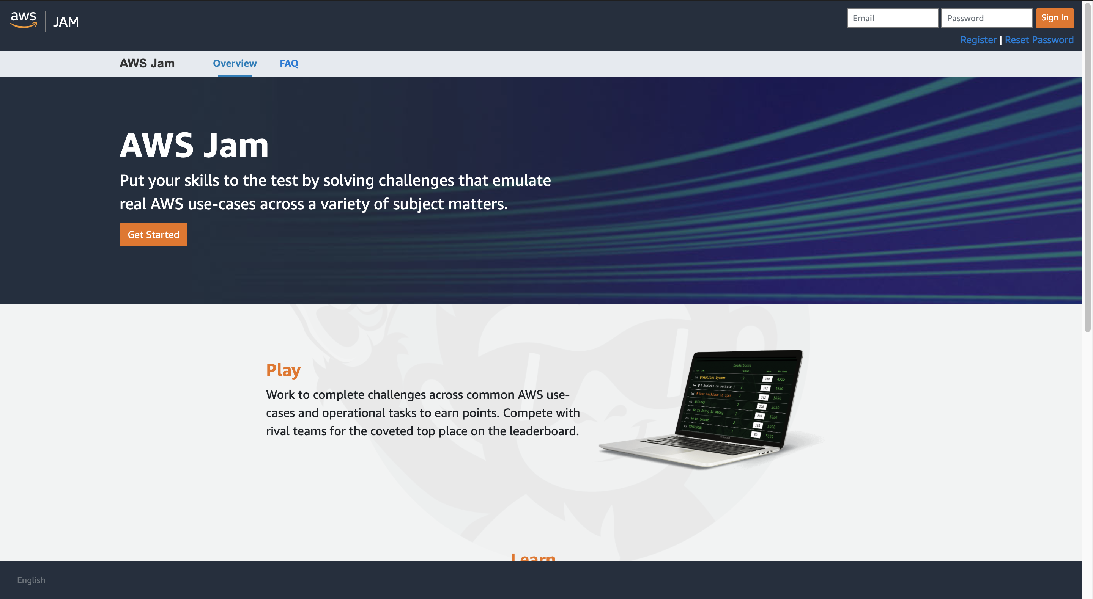
Registration
https://jam.awsevents.com

Slide 5
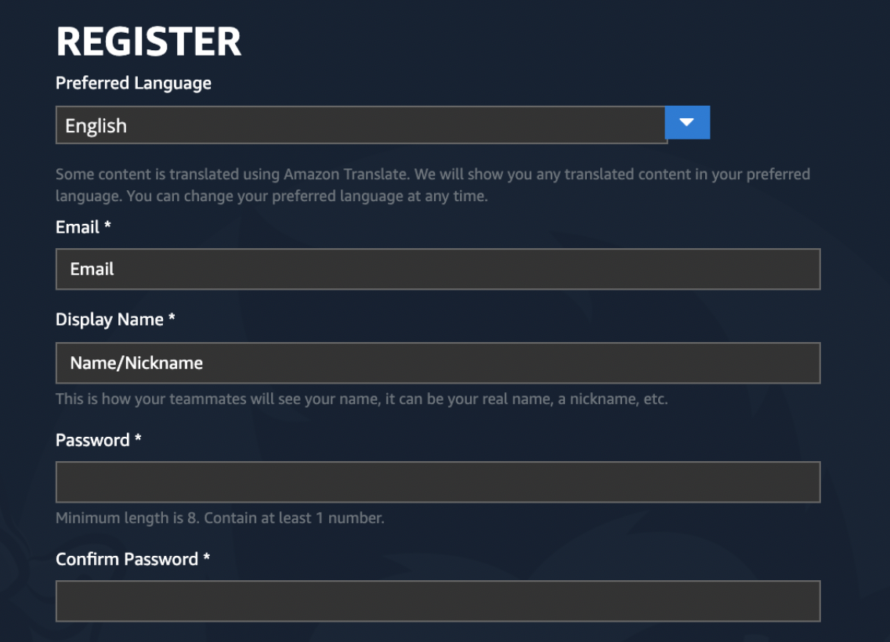
Registration

Slide 6
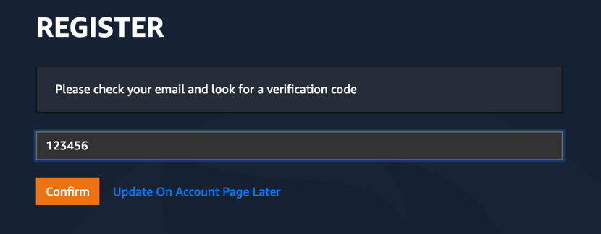
Verifying Your Account

Slide 7

Join The Event
Secret Key:
P@$$w0rd

Slide 8
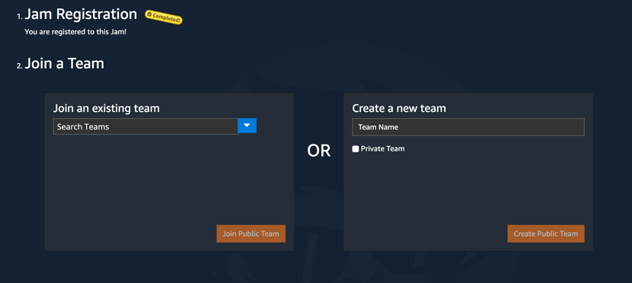
Join a Team

Slide 9
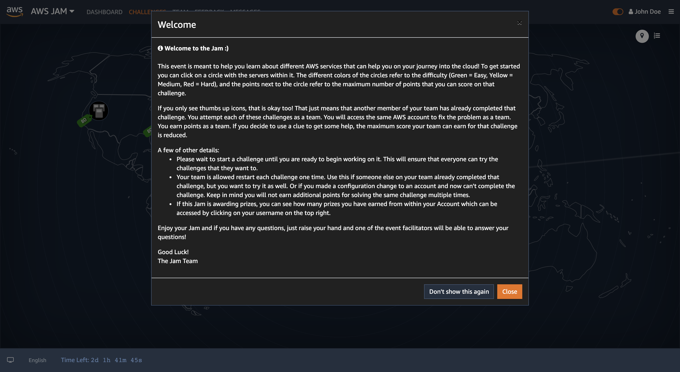
Welcome

Slide 10
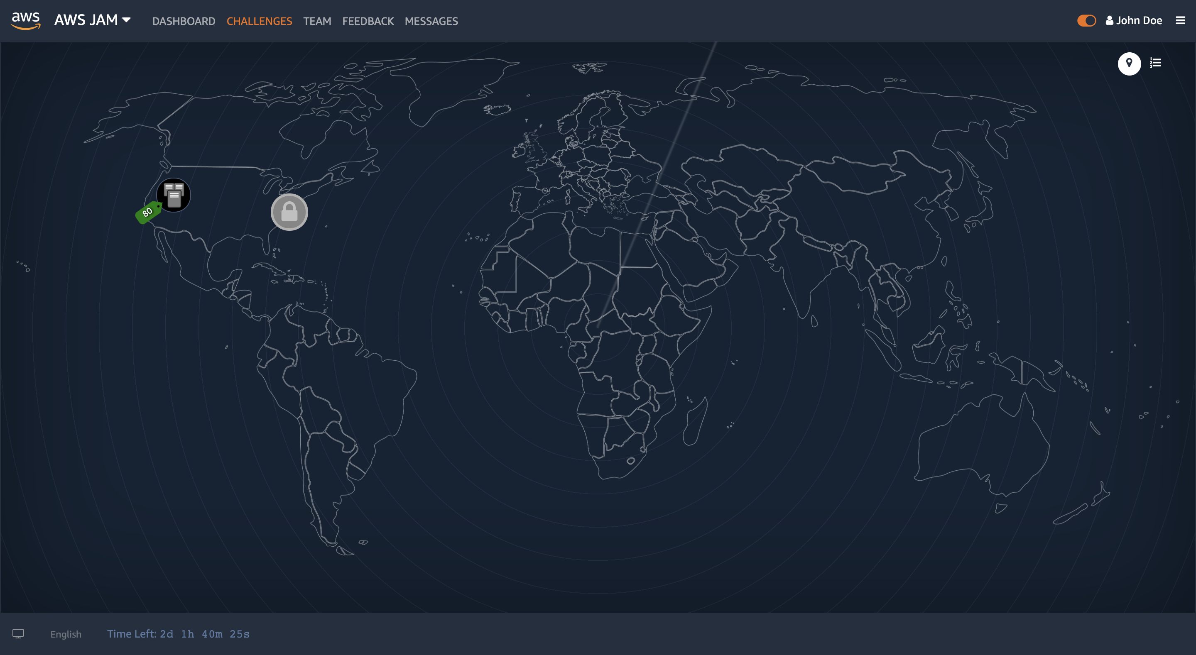
Jam

Slide 11
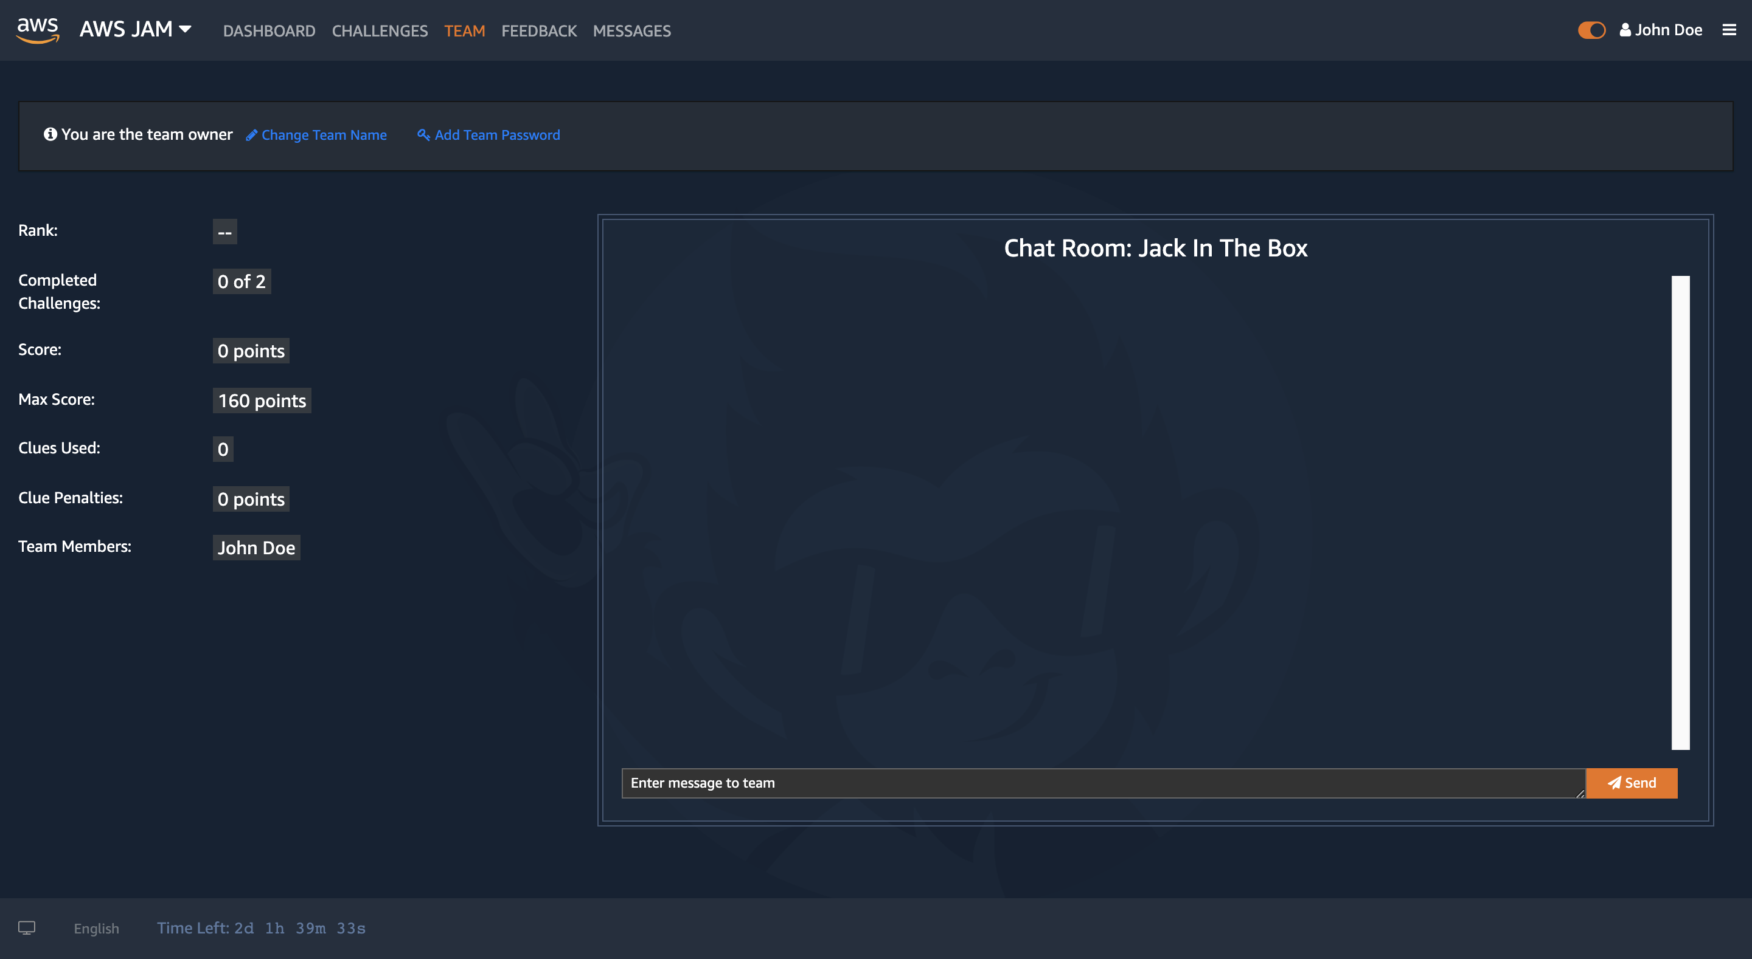
Team

Slide 12
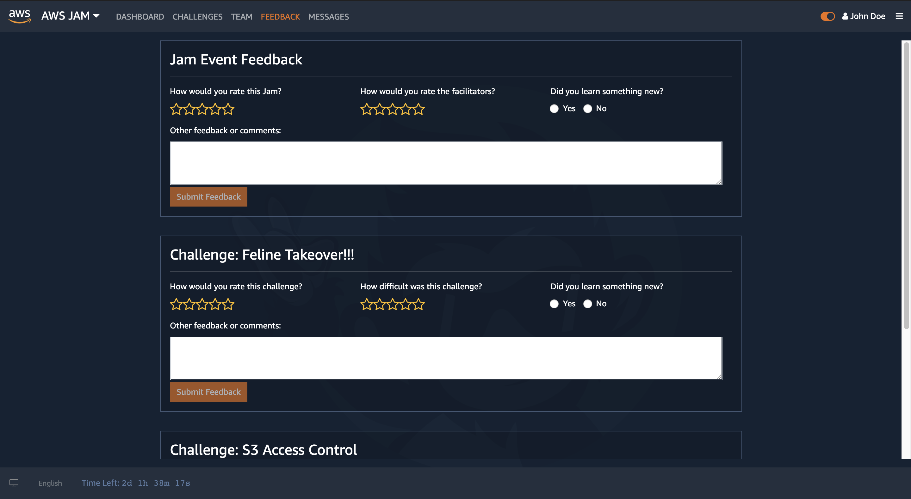
Feedback

Slide 13
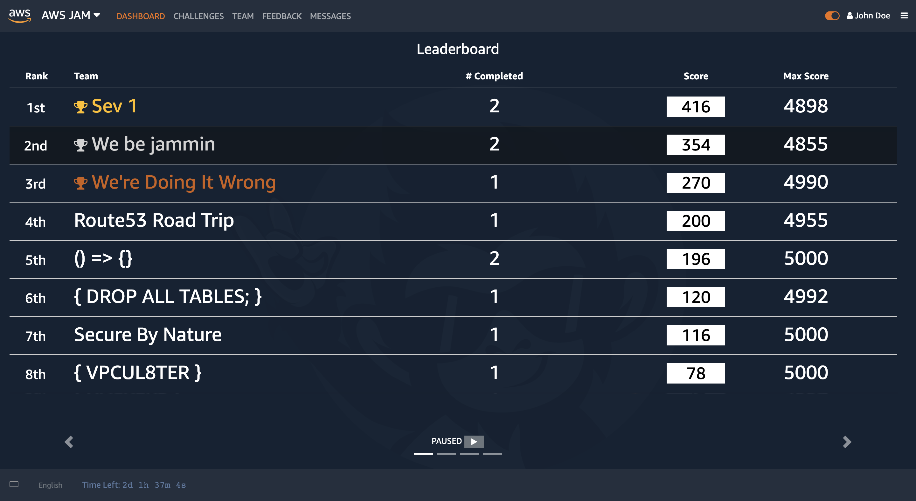
Dashboard

Slide 14
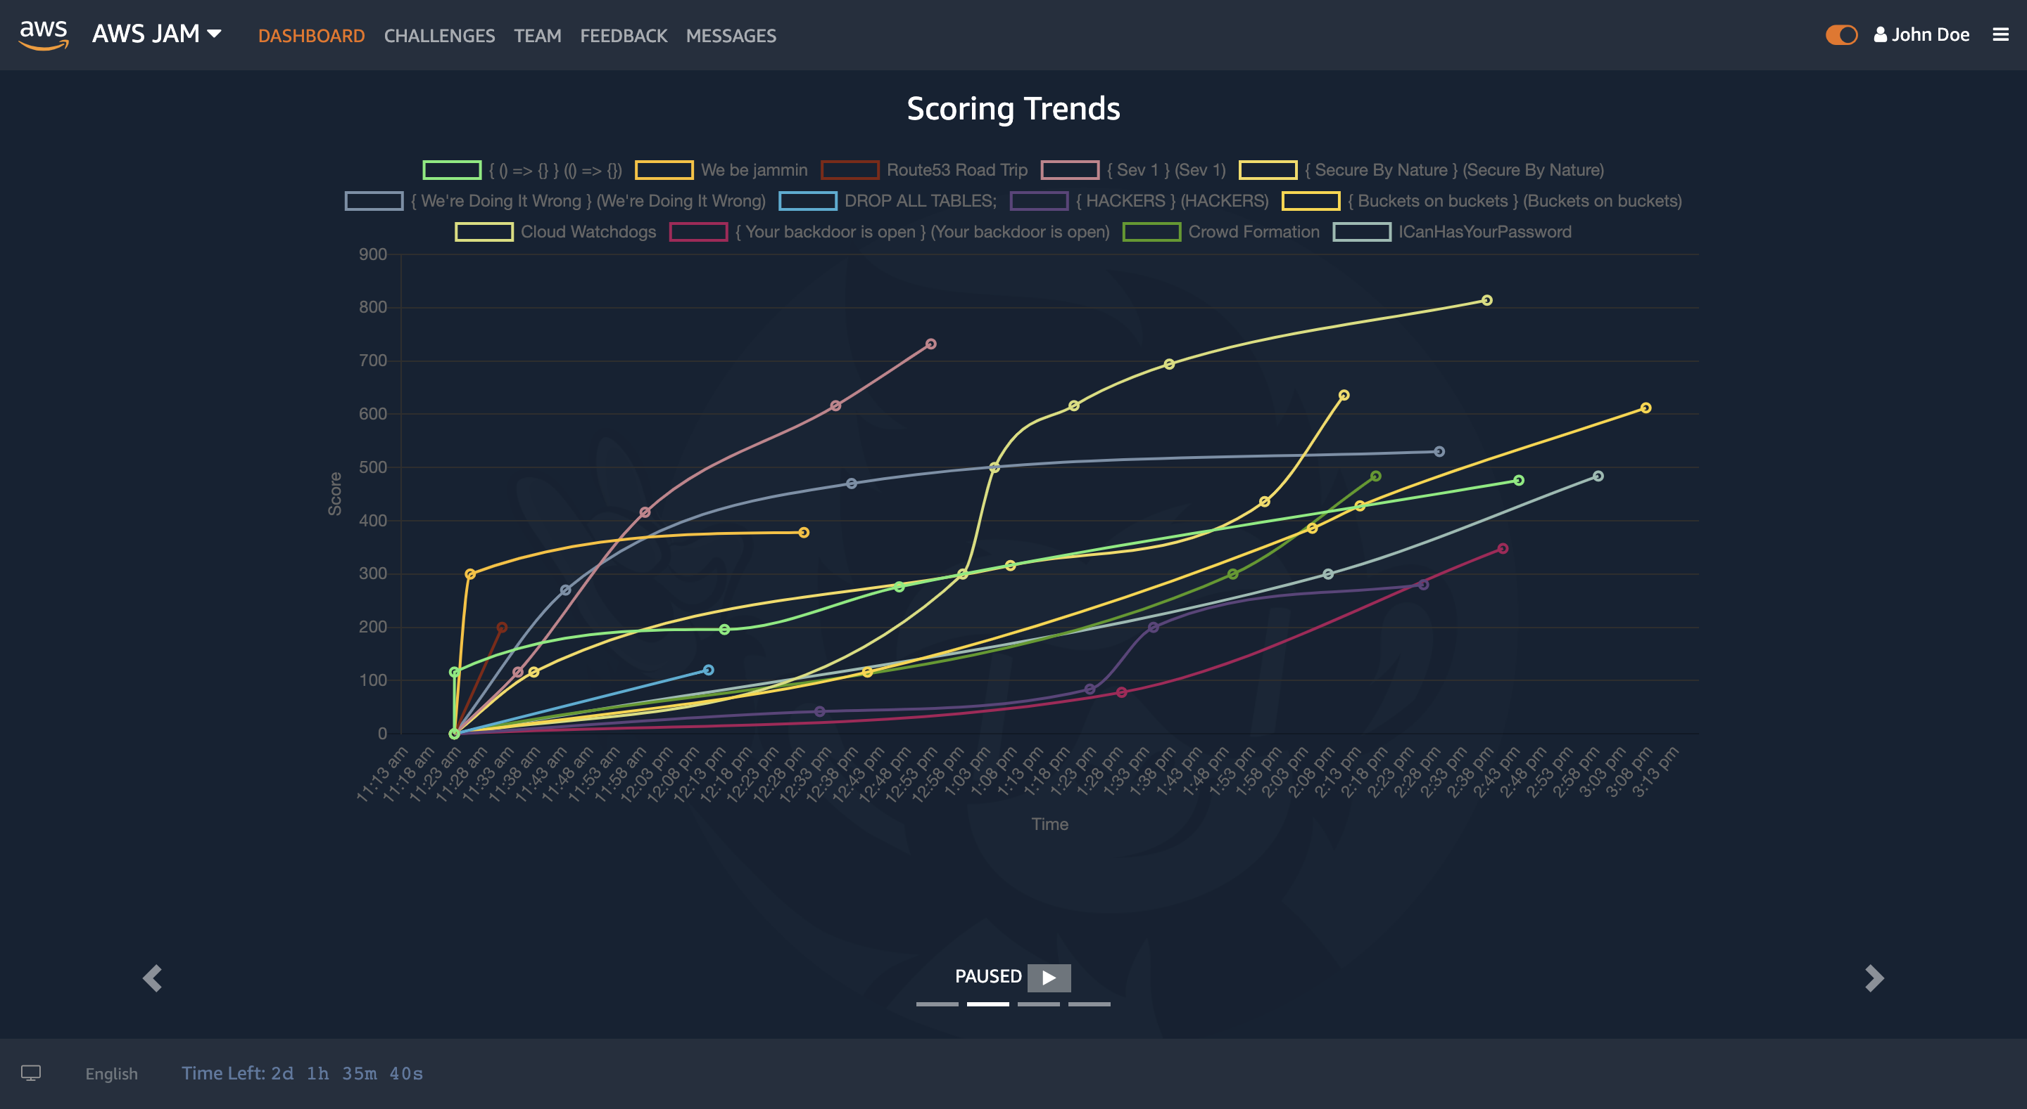
Dashboard

Slide 15
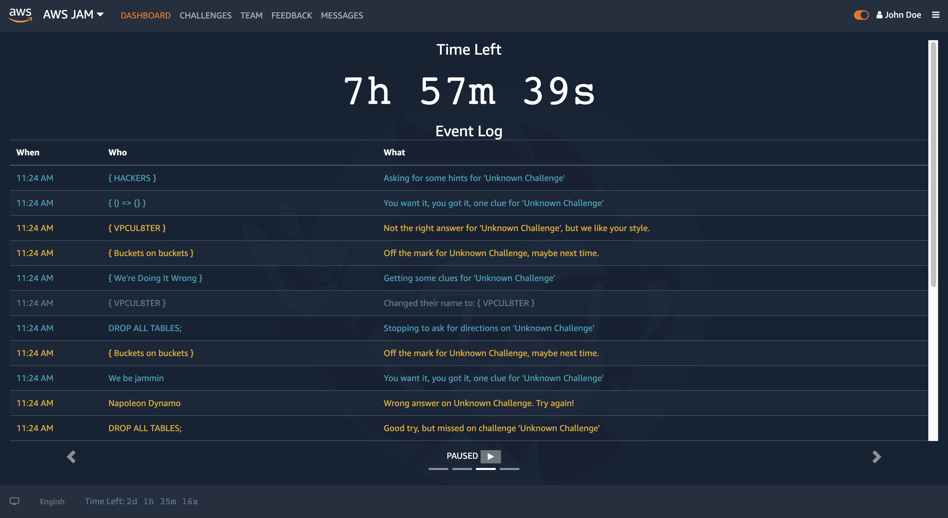
Dashboard

Slide 16
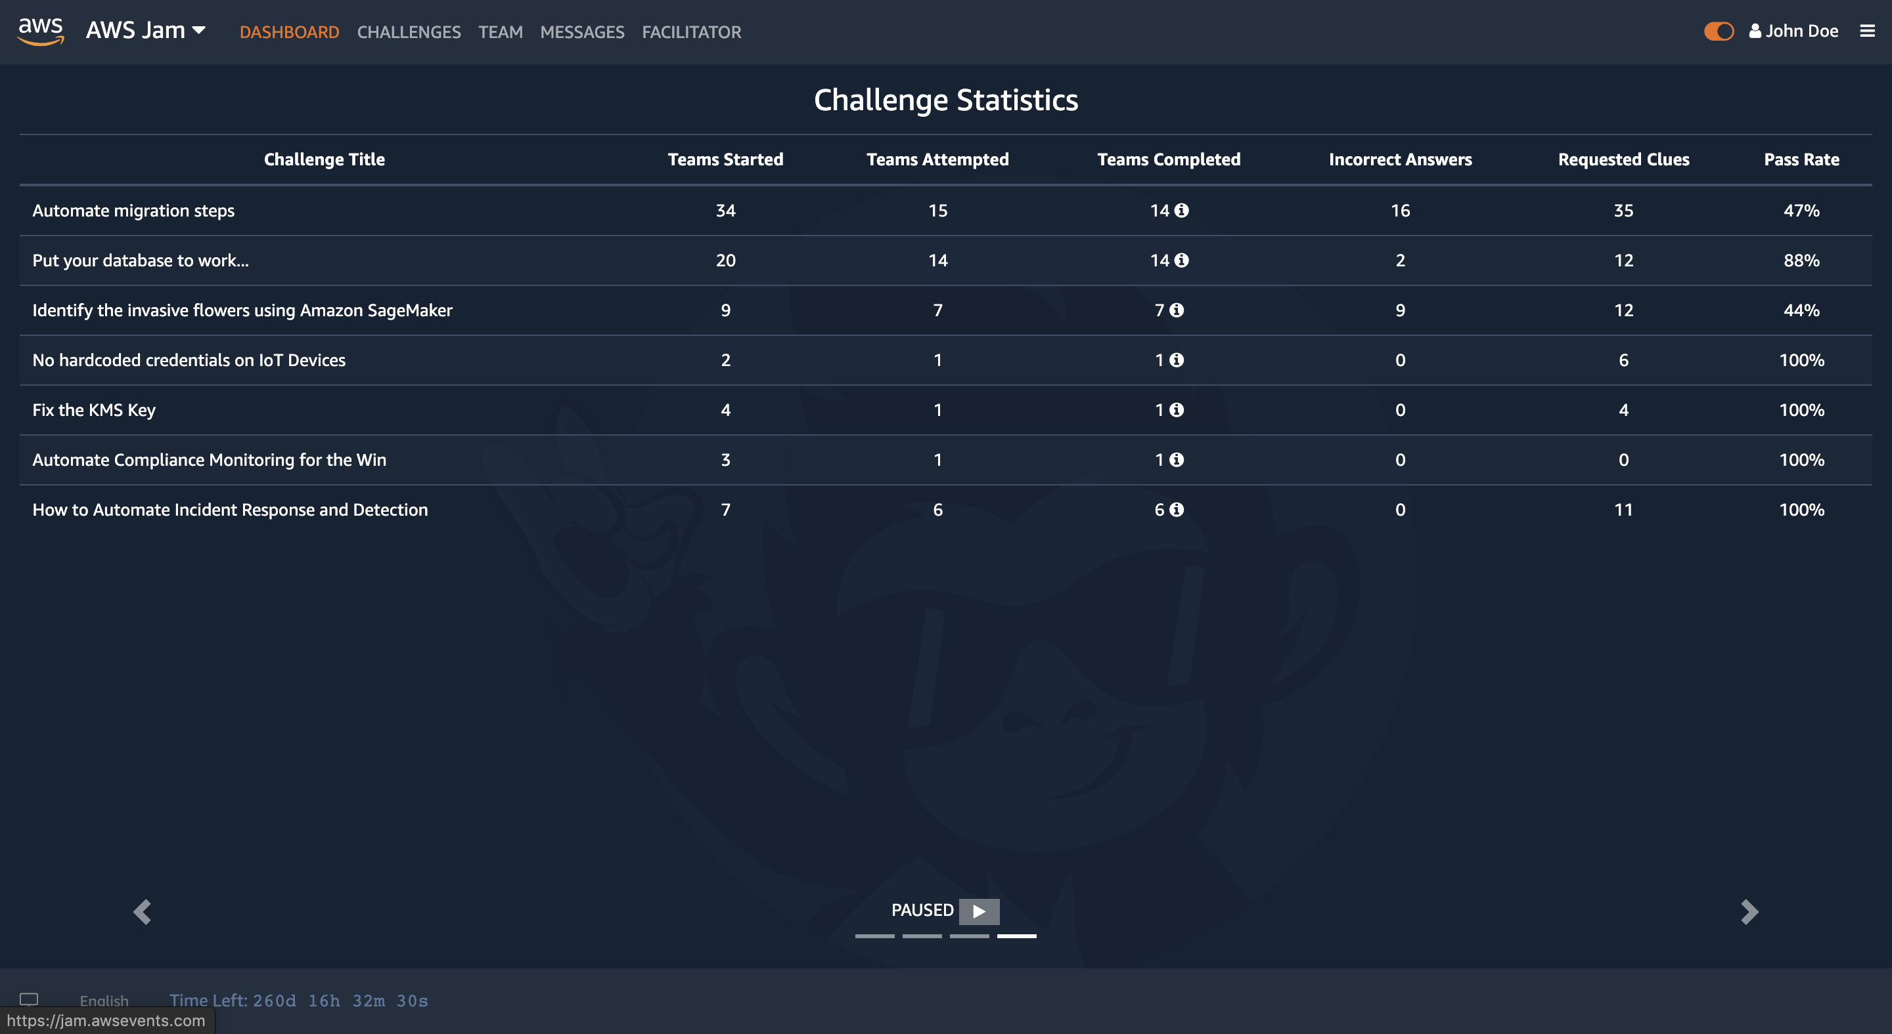
Dashboard

Slide 17
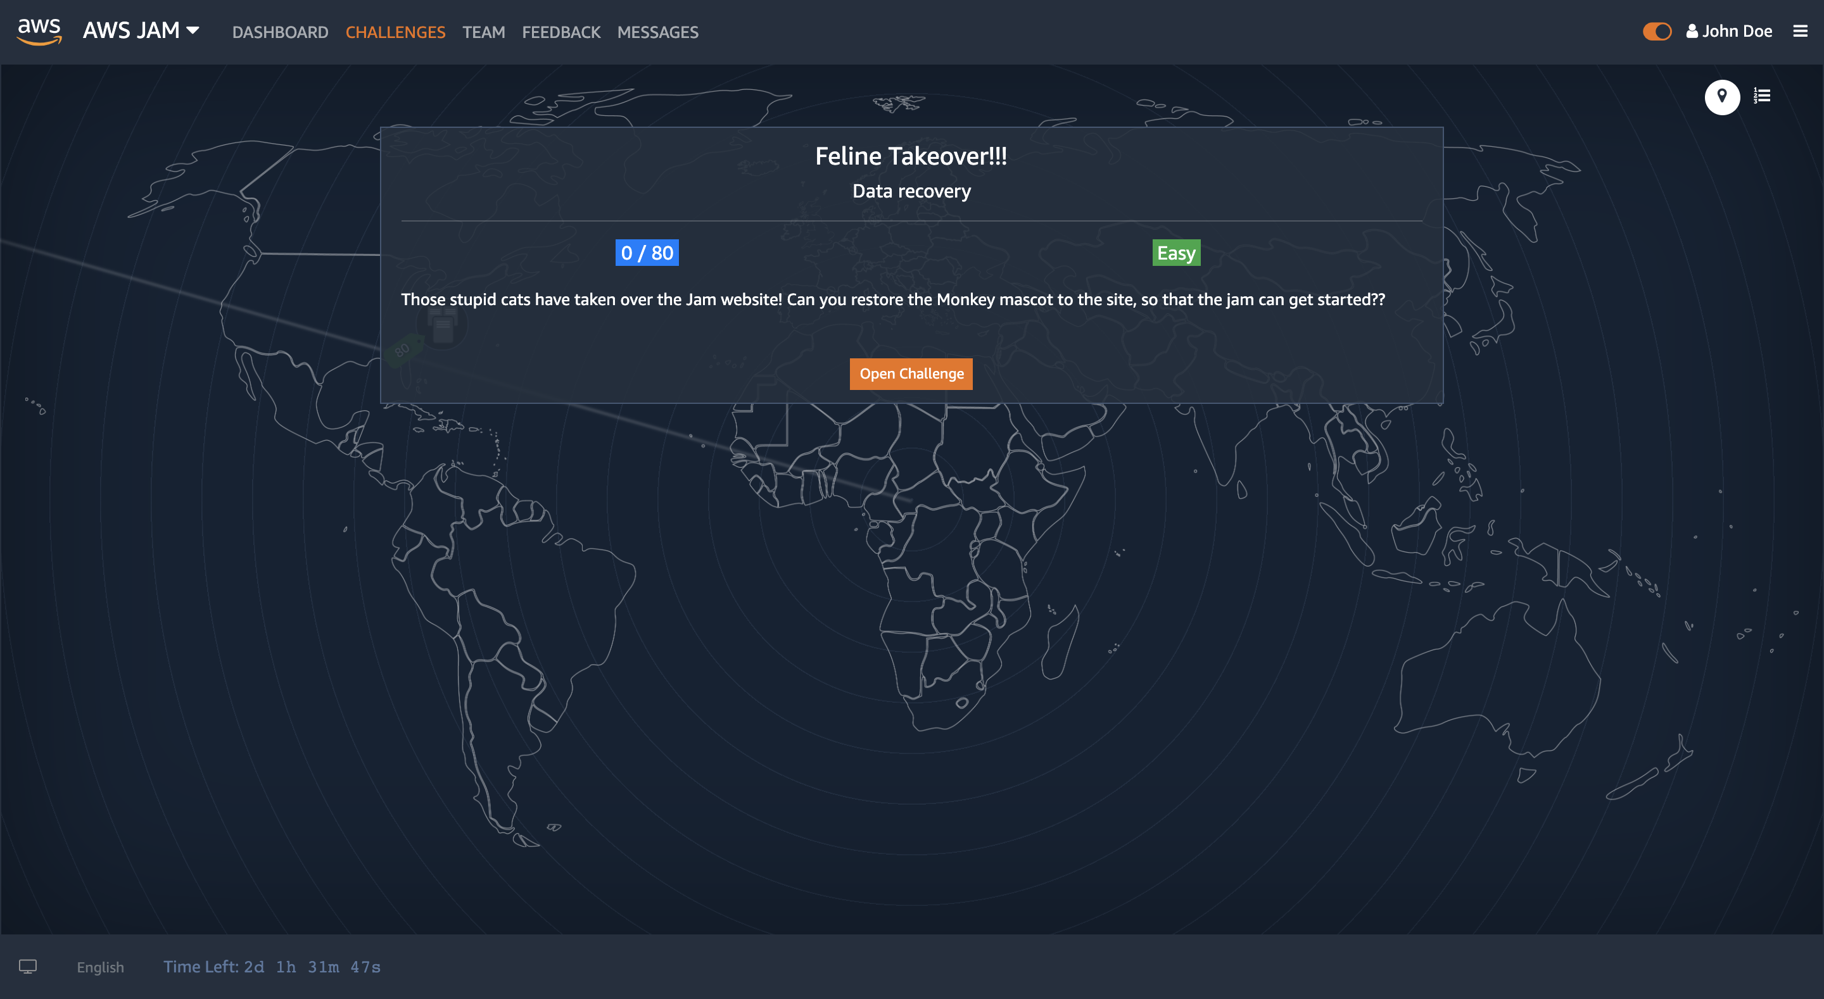
Challenge

Slide 18
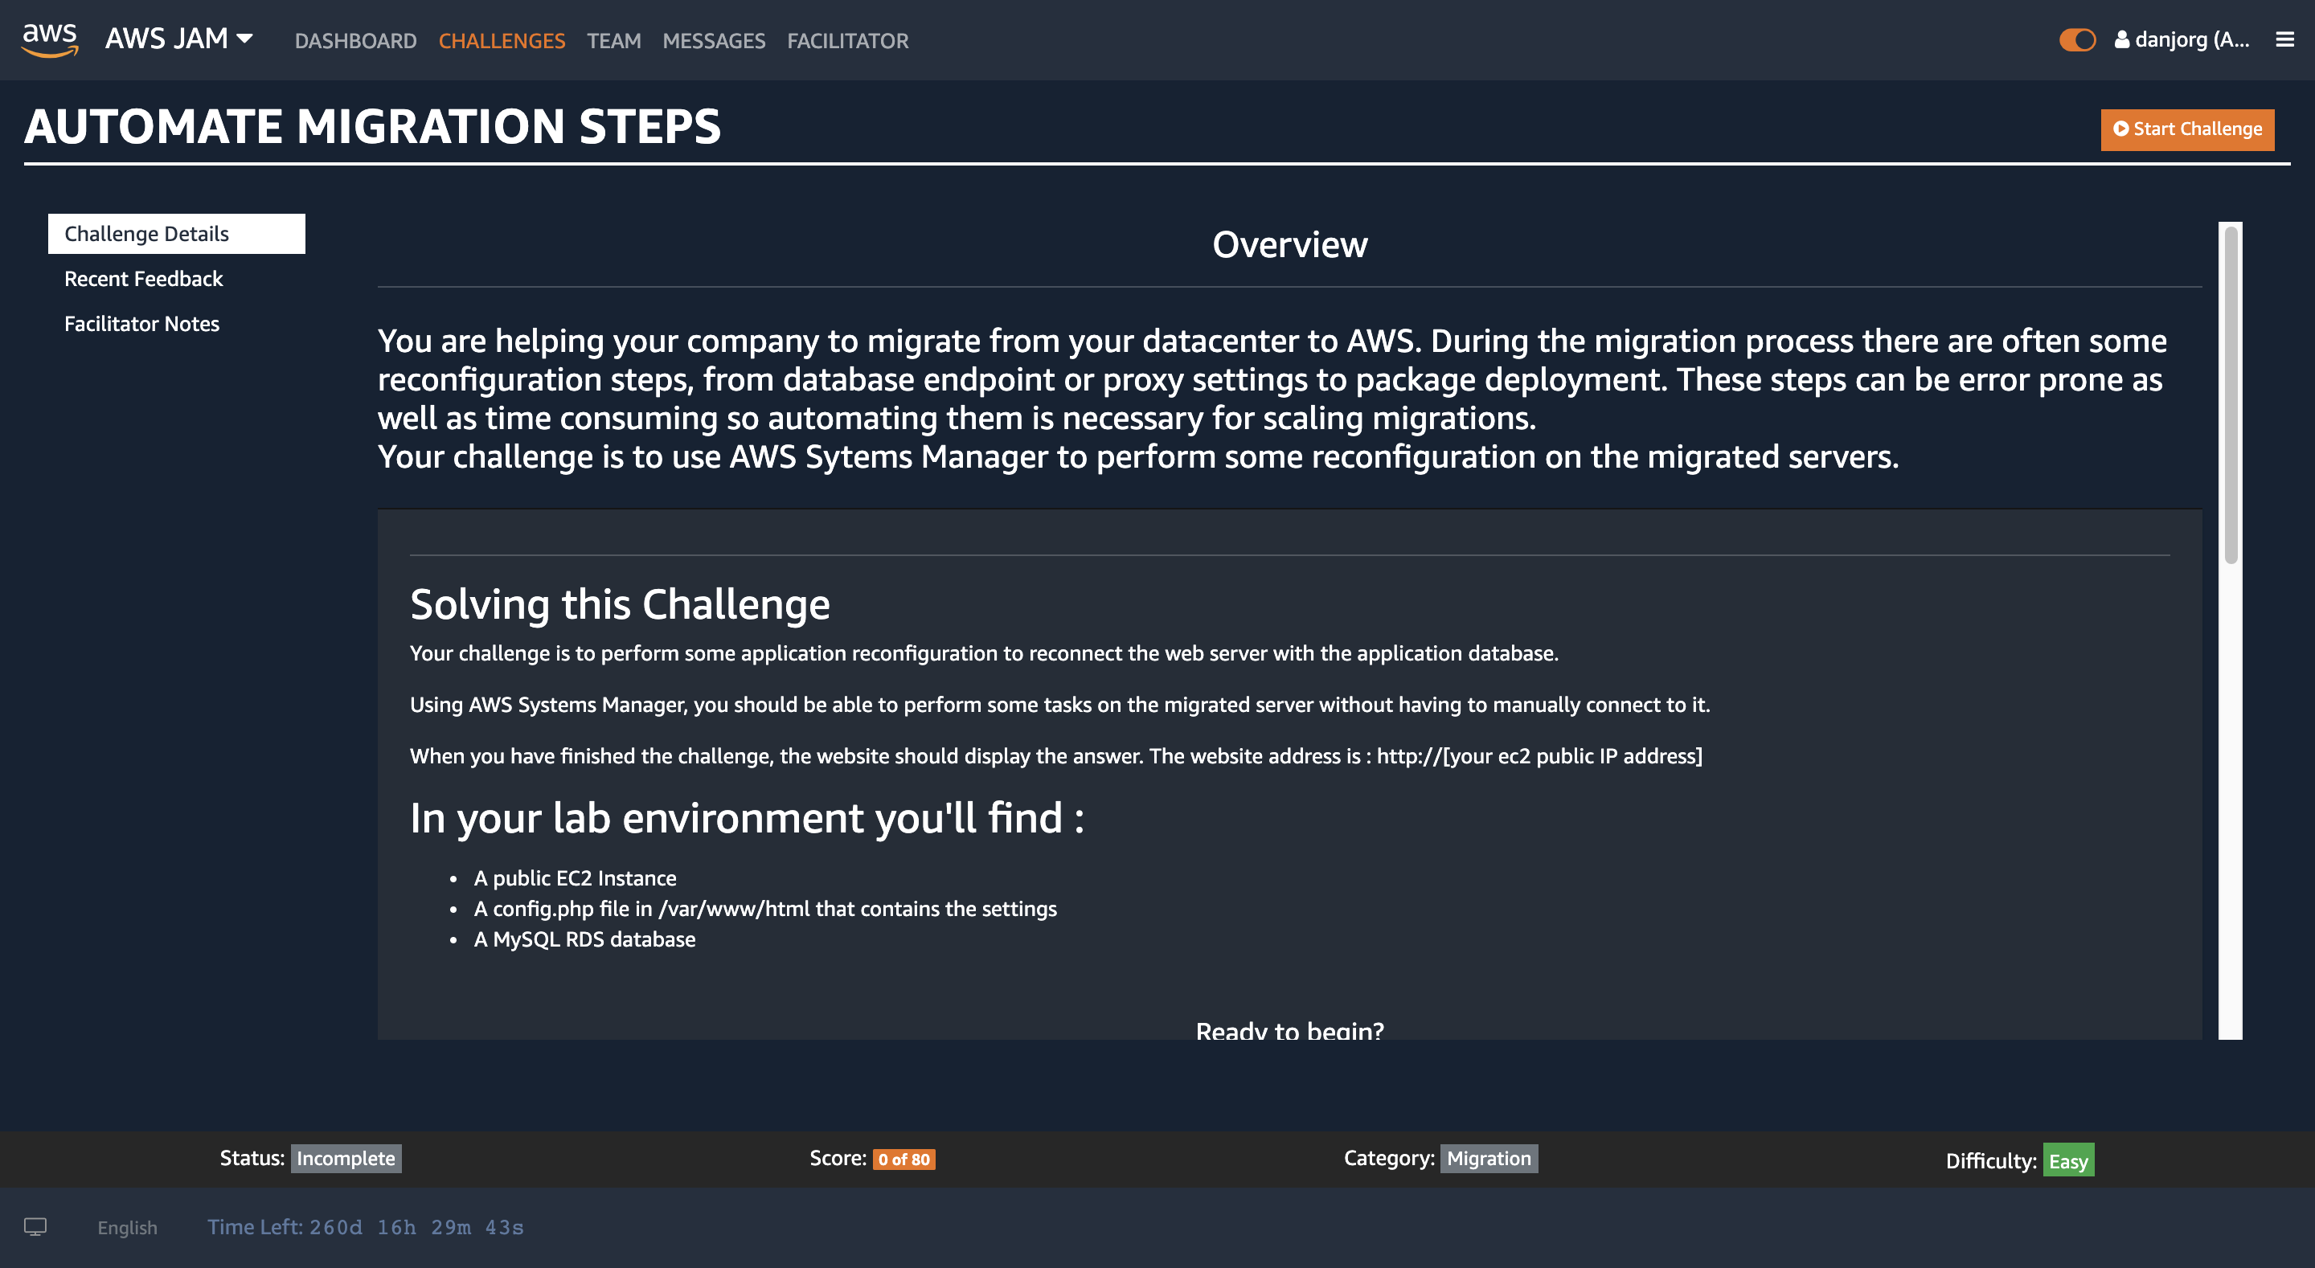

Challenge

Slide 19
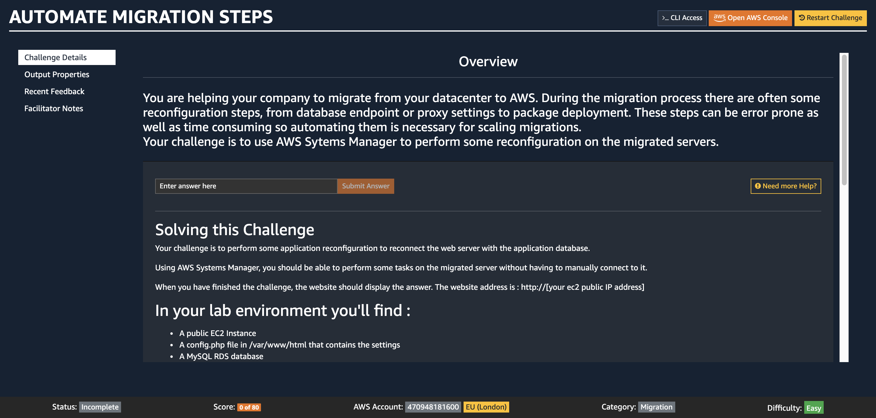

AWS Console Access / Restart Challenge

Slide 20
AWS Account & Region

Slide 21
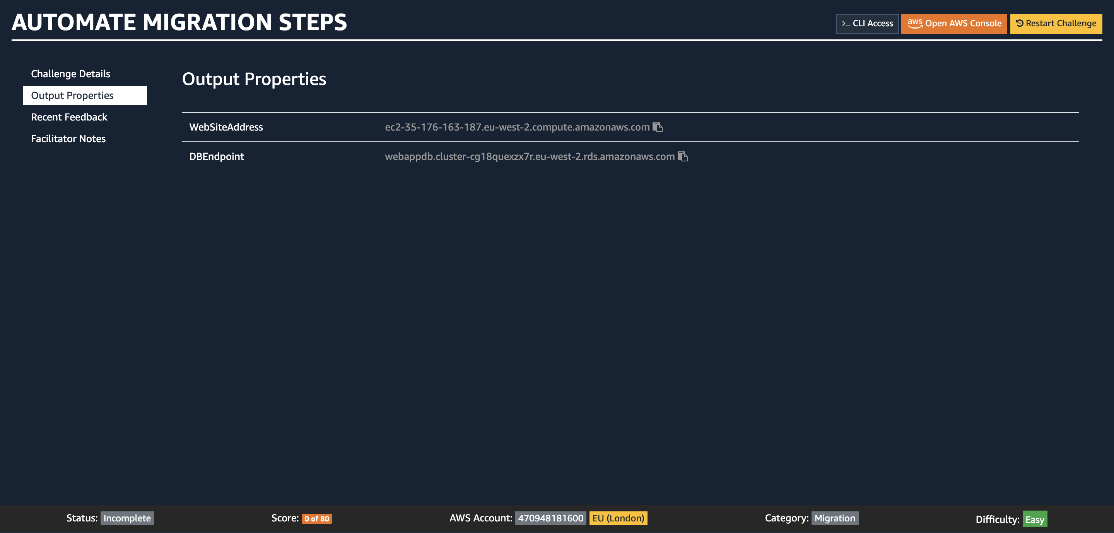

Output Properties

Slide 22
Challenge
Comfort Zone
Comfort Zone
Comfort Zone

Slide 23
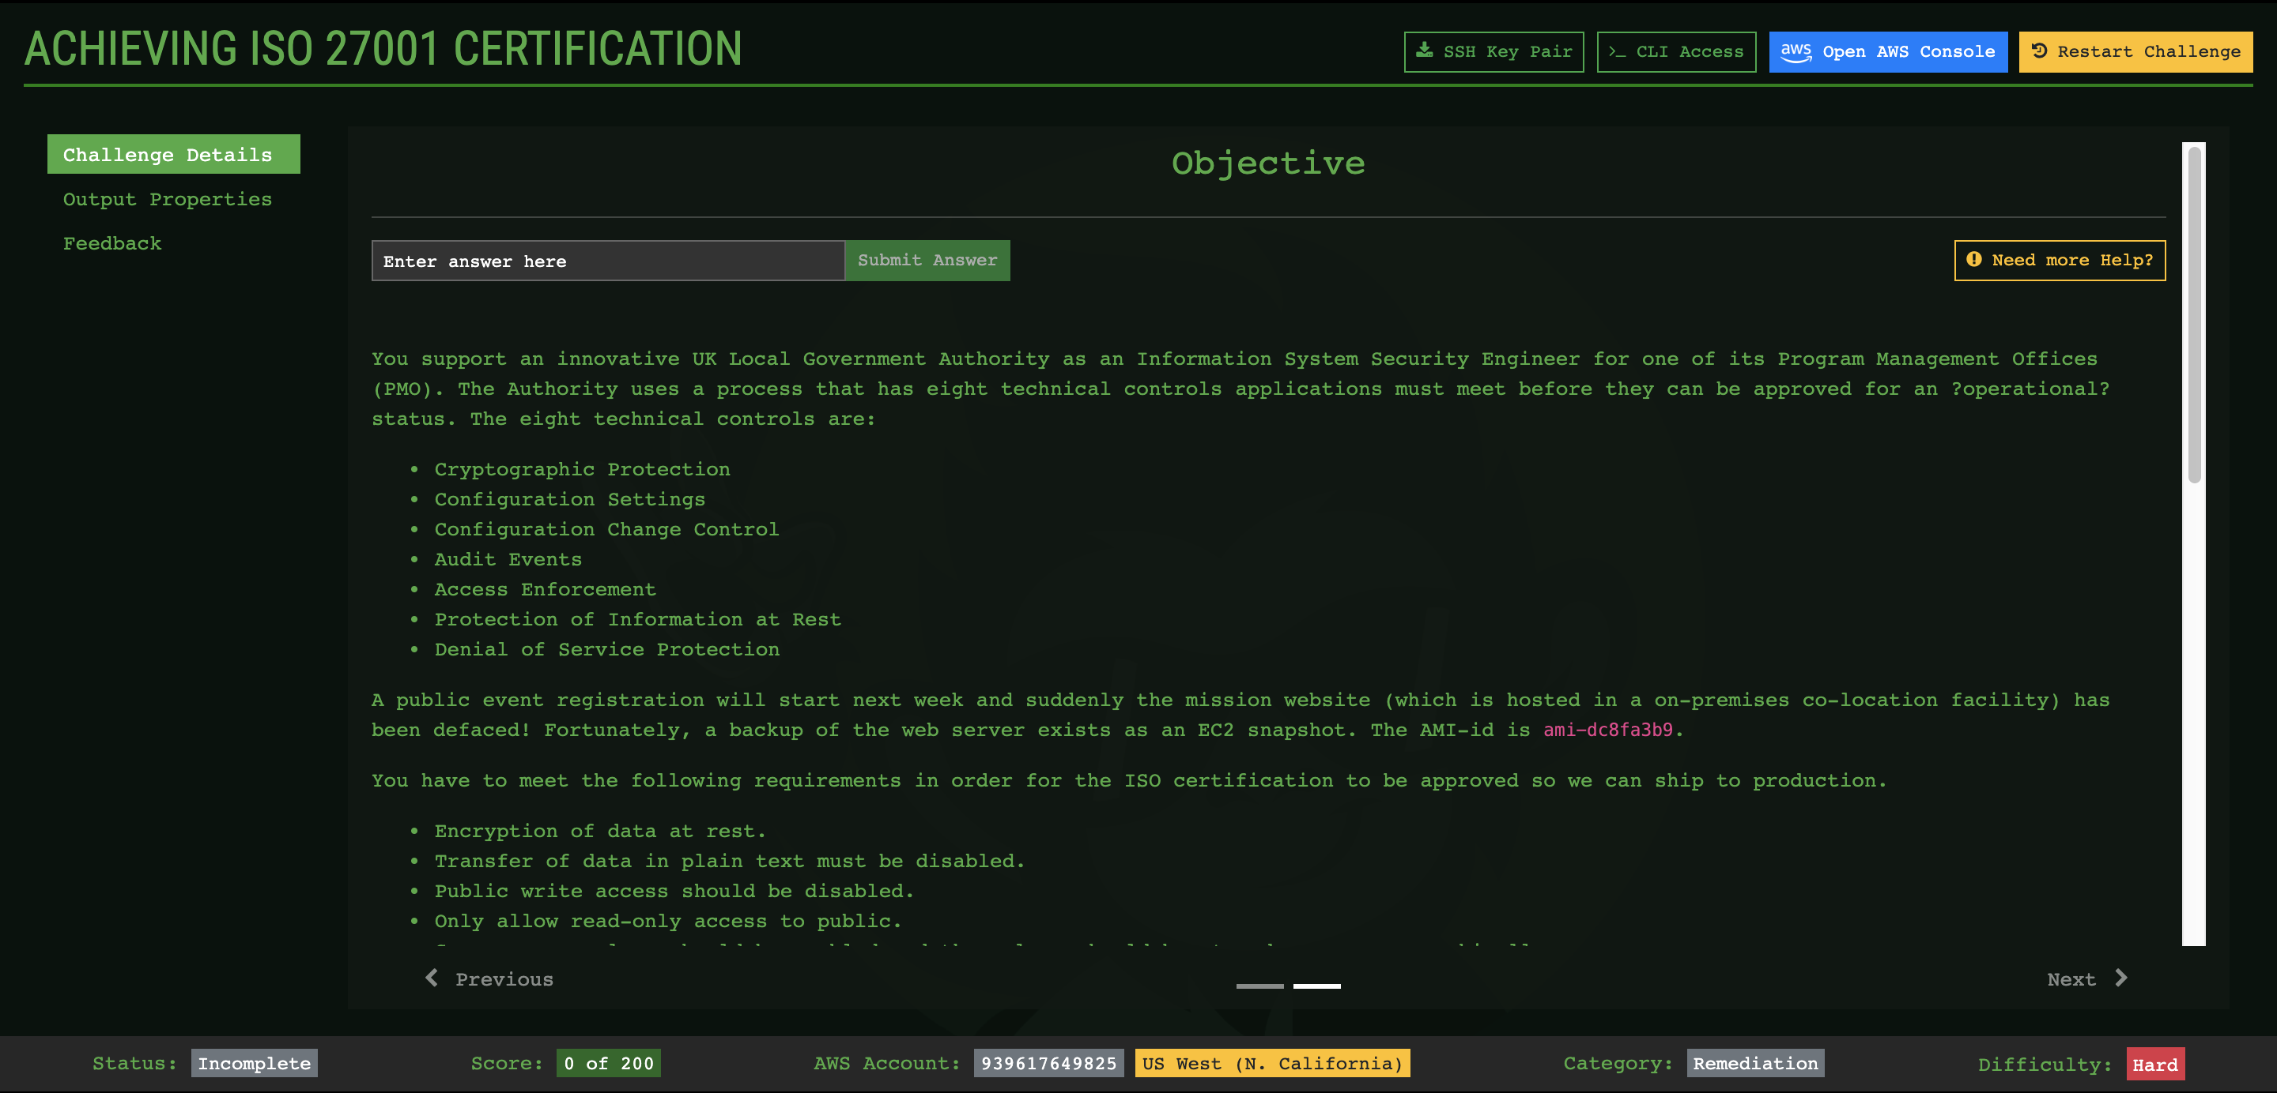
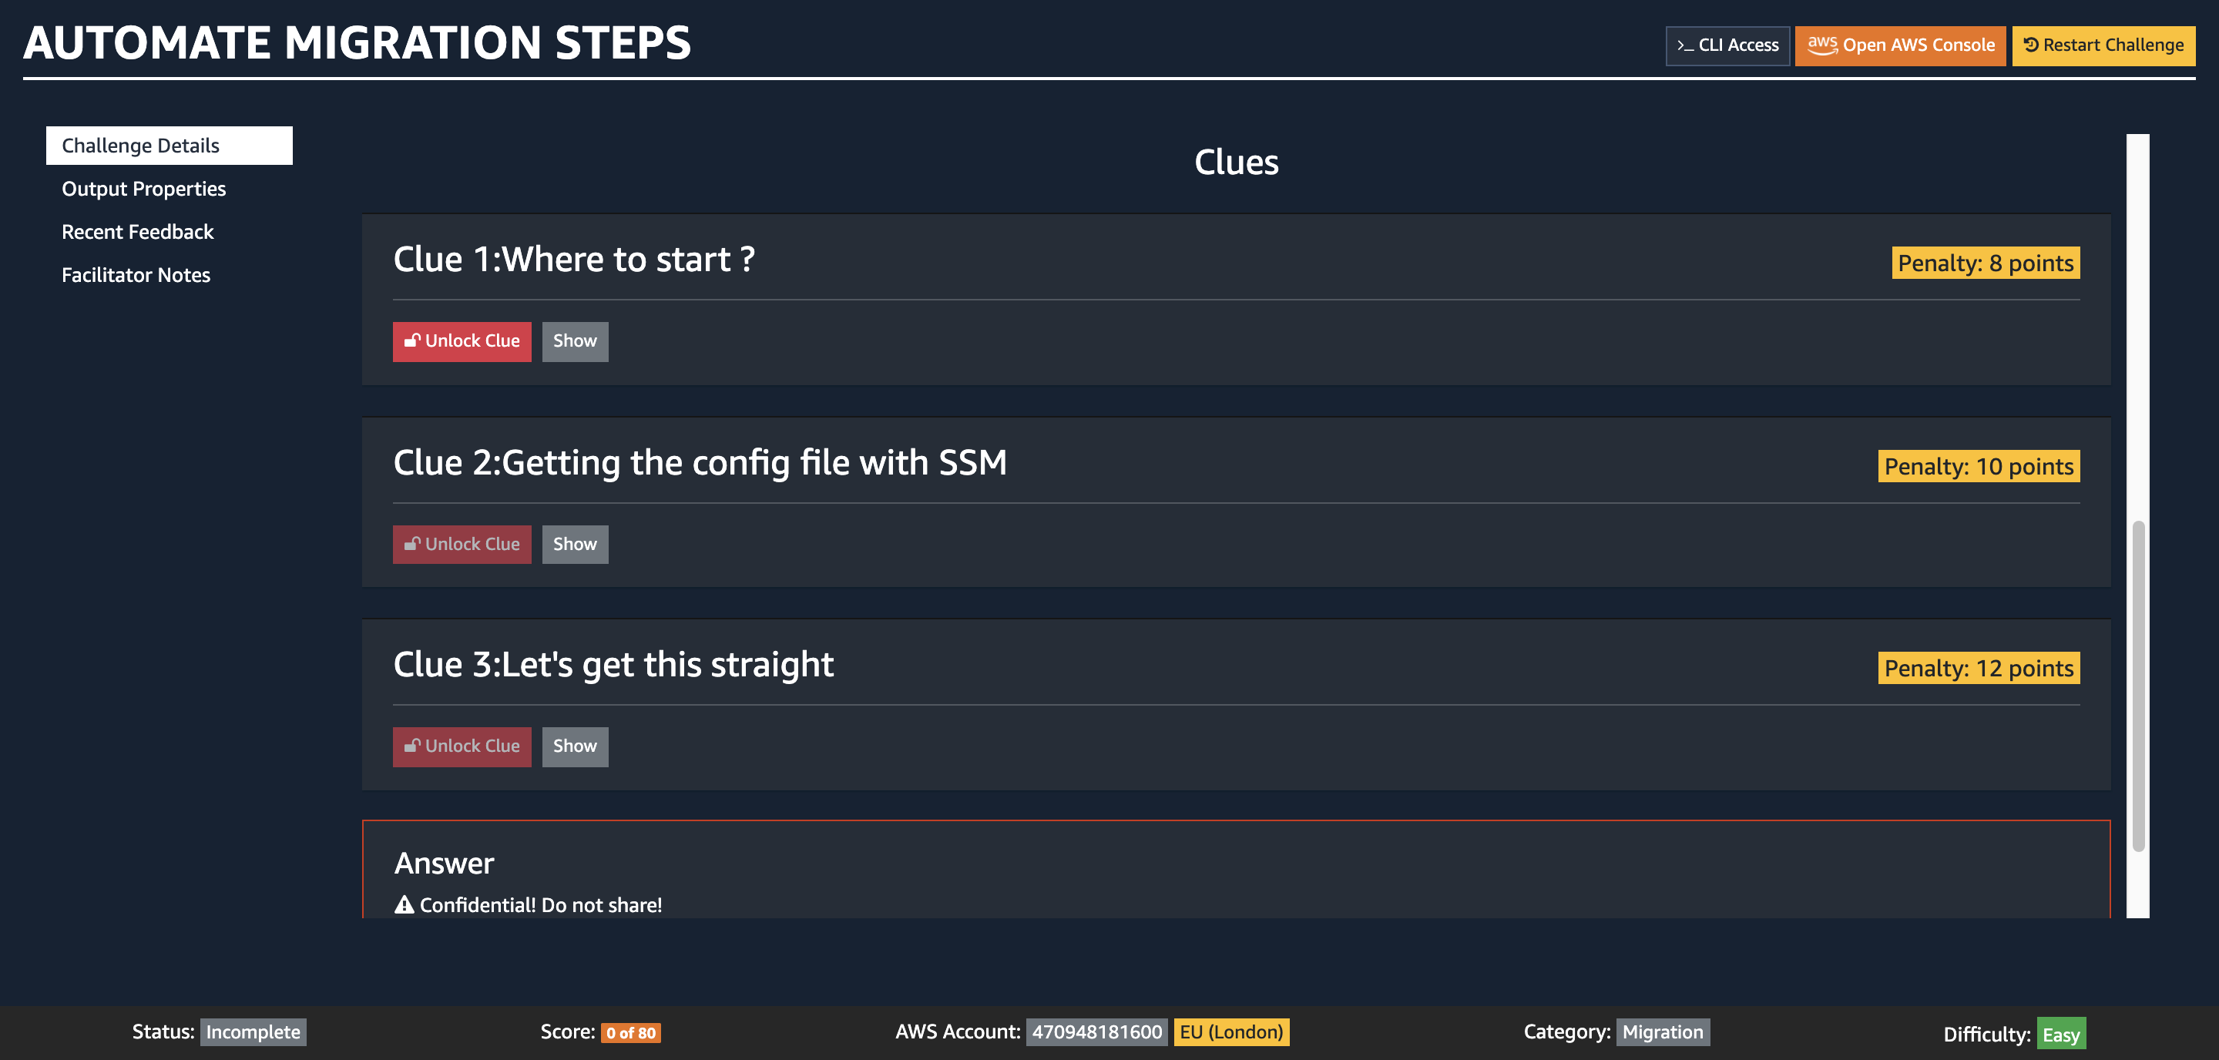
Clues (scroll down)

Slide 24

Clues not helping? Something broken? Ask for help!

Slide 25
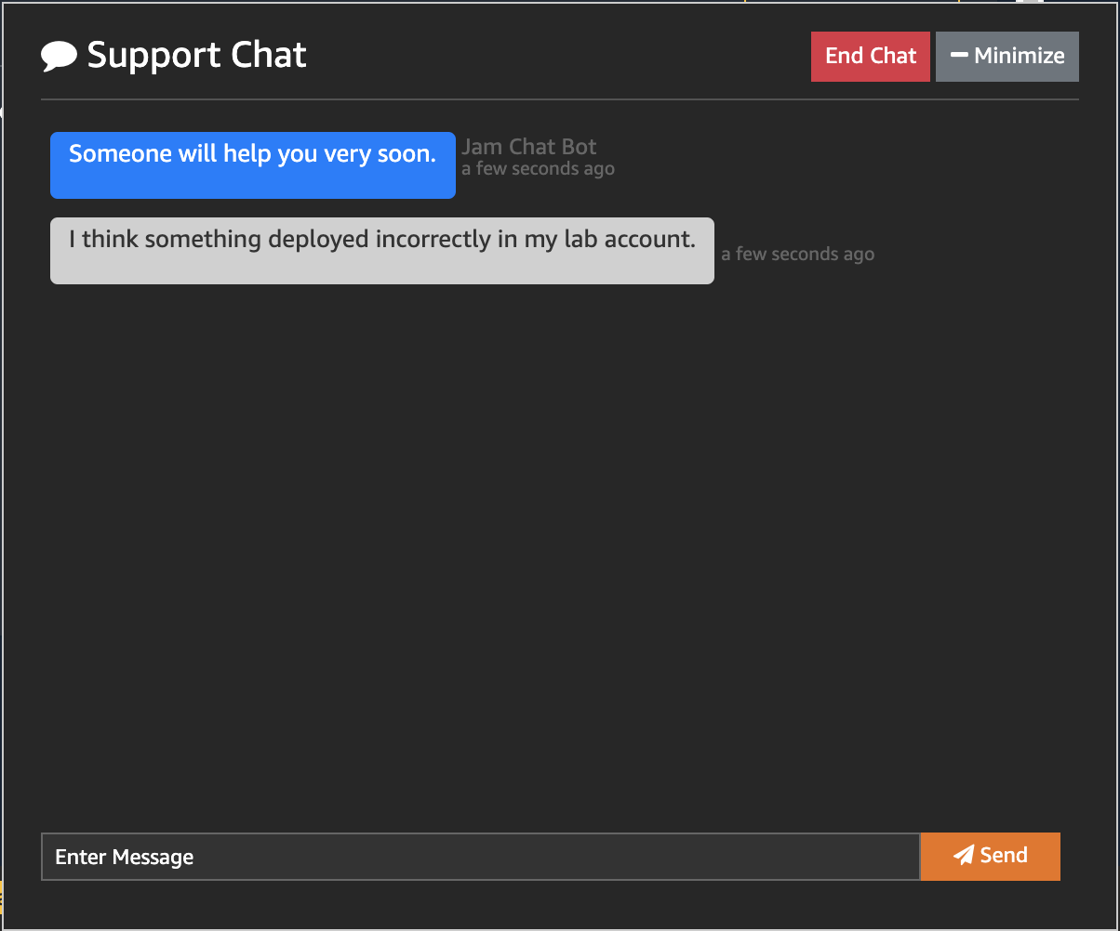
Support Chat

Slide 26
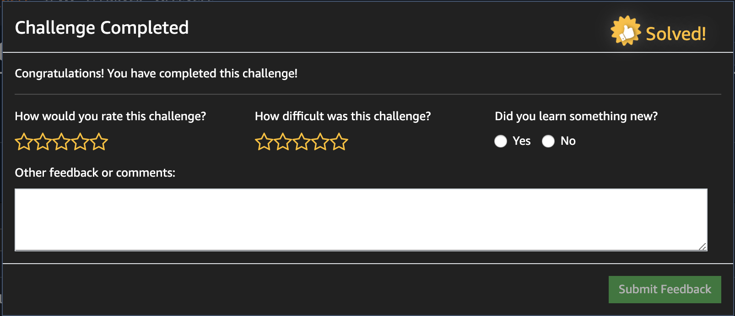
Completion & Feedback

Slide 27
Rules of the Jam
Work in the team
Lots of strategies work: Scrum or Divide and Conquer…
Team event!
Whole team gets the points.
Whole team gets the deductions.
Top of the leaderboard
Tie breaker: Time

Slide 28
Pro Tips
Stuck? Use a Clue. Ask a facilitator.
We’re here to guide you!
Playing to win? Max your points.
Save clues until you need them.
Playing to learn? Use the clues.
Last clue is always a walk-through.

Slide 29


Lets Get Jammin!!
1
2
4
5
3

Slide 30
AWS Jam
https://jam.awsevents.com
Secret Key: P@$$w0rd

